Slide 1


NEXT GEN EMPLOYABILITY PROGRAM
CREATING A FUTURE-READY WORKFORCE
Student Name :
VINOD
Student ID :
1CE22CS175
College Name :
City Engineering College

Slide 2
CAPSTONE PROJECT SHOWCASE
Project Title
Travel Website (Airbnb clone)
Abstract | Problem Statement | Project Overview | Proposed Solution | Technology Used | Modelling & Results | Conclusion | Q&A

Slide 3
Abstract
1
Brief introduction to the travel website project
2
Purpose: To simplify and enhance the travel planning experience for users
3
Key Features:
Destination search
Personalized recommendations
Booking options for transportation, accommodation, and activities
4
Importance of addressing user convenience and efficiency in travel planning

Slide 4


Problem Statement
Challenges faced by travelers:
Difficulty in finding reliable and comprehensive travel information.
Lack of a unified platform for booking different travel components.
Limited access to personalized recommendations.
Impact: Time-consuming and stressful planning process.

Slide 5

Project Overview
Objective: To create a user-friendly travel website that offers a one-stop solution for travel planning and booking.
Target Audience: Frequent travelers, holiday planners, and adventure enthusiasts.
Core Features:
User-friendly interface.
Real-time availability and pricing.
Integration of reviews and travel tips.

Slide 6
Proposed Solution
A centralized platform that:
Aggregates travel-related data (destinations, hotels, transportation, activities).
Provides user-specific recommendations using algorithms.
Ensures secure and seamless booking processes.
Incorporation of dynamic and responsive design for enhanced user experience.

Slide 7
Technology used
Frontend: React.js, CSS, HTML for an interactive user interface.
Backend: Node.js, Express.js for server-side logic and APIs.
Database: MongoDB for storing user data, bookings, and reviews.
Third-Party APIs: For fetching travel data, maps, and real-time updates.
Tools:
Version Control: Git/GitHub.
Deployment: AWS or Firebase.

Slide 8
Modelling & Result
System Architecture
Frontend: React.js handling user interface and interactions.
Backend: Node.js and Express.js managing APIs and logic.
Database: MongoDB storing user data, travel details, and bookings.
Third-party APIs: Integration for travel data, maps, and real-time updates.

Slide 9
Modelling & Result
User Flow & Features
A flowchart of the user journey:
Search: User searches for destinations or travel packages.
Filter: Options filtered by user preferences.
Booking: Seamless checkout and payment process.
Post-Booking: Confirmation and reminders.
Key Features Highlighted:
Search bar with autocomplete.
Personalized recommendations based on user history or preferences.
Secure payment gateway integration.

Slide 10
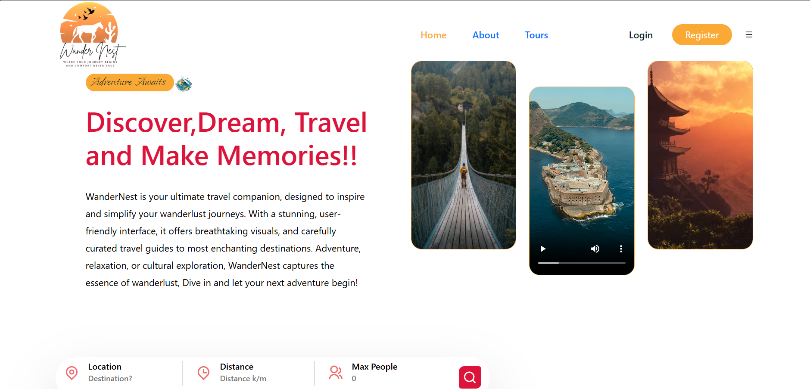
Modelling & Result

Slide 11

Conclusion
Summary of the project’s impact:
1.Streamlined travel planning.
2.Enhanced user satisfaction and convenience.
Future Prospects:
1.Adding AI-based chatbots for travel assistance.
2.Integration with more third-party services for added features.

Slide 12


Notes:
Thank You !!

